Slide 1
MCTE 3104 Mechatronics Interfacing Lab
Session no. 9 : Introduction to IOT (Part I)

Slide 2
Outline
HTTP (Hypertext Transfer Protocol)
Http and how the web works
HTTP Methods
REST API
Firebase Real-time database for IOT application
Create a real-time database
Create api for hardware and software interfacing

Slide 3
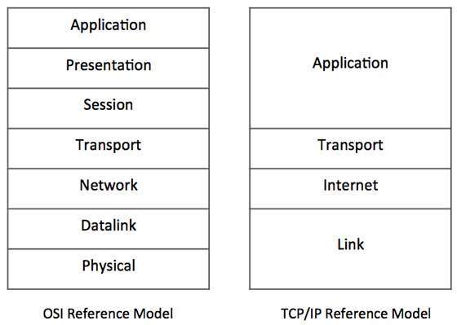
HTTP protocol
HyperText Transfer Protocol
One of the most widely used internet protocol in the world.
HTTP is an application layer protocol that allows web-based applications to communicate and exchange data
Think the HTTP as the messenger of the web
It is a TCP/IP based protocol
It is used to deliver contents, for example, images, videos, audios, documents, etc.
The computers that communicate via the HTTP must speak the http protocol
HTTP exist here!

Slide 4
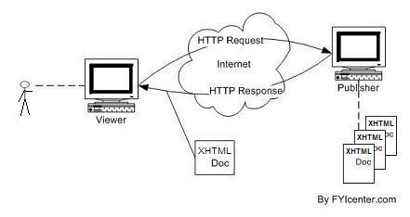
The Request-Response Cycle
server
client
file
file
file
file
Say a user wants to see a website and types in a url of the page usually on a browser.
The user needs to be physically connected to the internet; this is where the TCP/IP protocol makes communication on physical connection between machines possible.
When the connection is established, the client sends a request called HTTP message and then disconnects from the server waiting for a response.
The server on the other hand prepares the response, establishes the connection again and send back the response called HTTP message to the client and then disconnects.

Slide 5
HTTP Messages
A typical HTTP message contains 3 main sections
Start line
Headers
Plain text based information
Body

Slide 6
The information in the three sections differs depending on whether it is a request or a response message
Request Http message
1
2
3
Method path/to/file.ext http/version
1. The Method is the command that tells the server what to do like:
GET - read
PUT - update/replace
POST - create
DELETE - delete
2. The URI (uniform Resource Identifier) a series of readable character to locate a resource in a server
3. Http version you are using
Name1: value1
Name2: value2
Name3: value3
ex. Some content

Slide 7
The information in the three sections differs depending on whether it is a request or a response message
Example: Request Http message
Headers are pair values. There could be a lot of headers but we’re sticking with 3 for this example. Here we are setting the Host which is the address of the server to which we’re sending the request. Accept-language specify the language to English. Accept the type of file we’re requesting.
Here sometimes the body is not needed for a request.
GET /section1/item1.html HTTP/1.0
Host: www.example.com
Accept: text/html
Accept-languages: en-us

Slide 8
The information in the three sections differs depending on whether it is a request or a response message
Response Http message
1
2
http/version status code
http version you are using
Status code tells the client if the request succeeded or failed
Ex. : 200: ok
404: file not found
Name1: value1
Name2: value2
Name3: value3
ex. Some content

Slide 9
The information in the three sections differs depending on whether it is a request or a response message
Example: Request Http message
HTTP/1.0 200: OK
Host: www.example.com
Accept: text/html
Accept-languages: en-us
Html contents

Slide 10
REST API
An API for a website is code that allows two software programs to interface with each other with each another.
A RESTful API is an Application Program Interface (API) that uses HTTP requests to GET, PUT, POST and DELETE data.

Slide 11
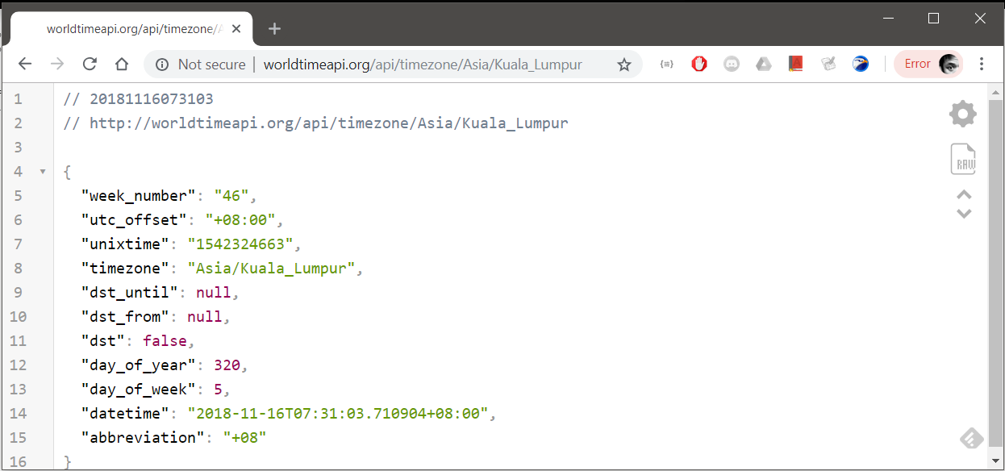
Consider this REST api service that returns you current time information of Kuala Lumpur
http://worldtimeapi.org/api/timezone/Asia/Kuala_Lumpur
Results from requesting from an internet browser

Slide 12
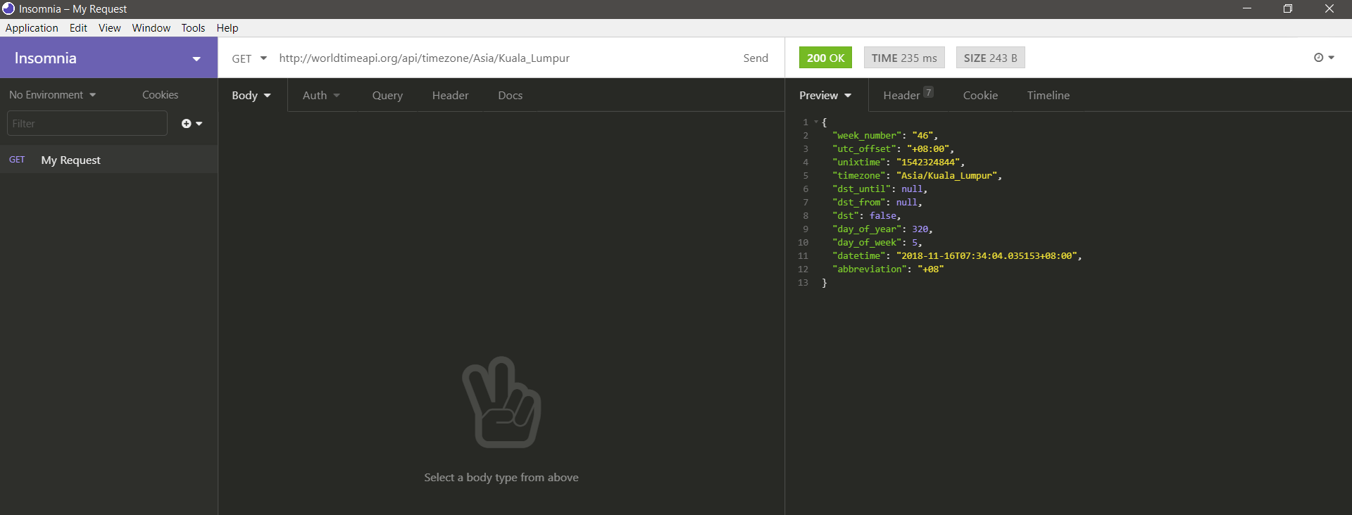
Consider this REST api service that returns you current time information of Kuala Lumpur
http://worldtimeapi.org/api/timezone/Asia/Kuala_Lumpur
Results from requesting from an REST Api debugging software
Insomnia is a free REST Api debugging software that can be downloaded from https://insomnia.rest/

Slide 13
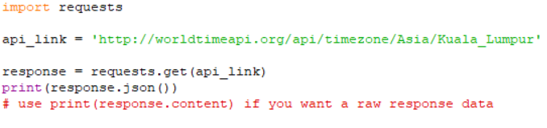
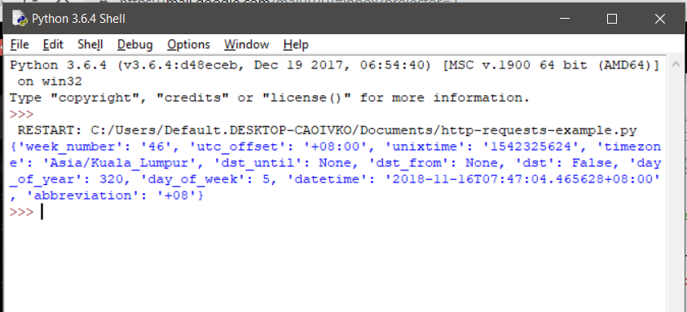
Python’s Requests library
Python comes in with a built-in requests library which allows you to make Http requests.
Example 1: Making simple GET requests
Results from requesting from a python script

Slide 14
Http request a REST Api
Lab activity 1:
Find a free online REST API service and make GET requests using browser, insomnia and python script.

Slide 15
Firebase Real-time Database for IOT application
Google’s firebase platform allows you to make a real-time database for high-quality apps.
Luckly anyone with a google account can create one free real-time database per project.
Database structure support json style format.
You can easily create api calls to update components of the database.

Slide 16
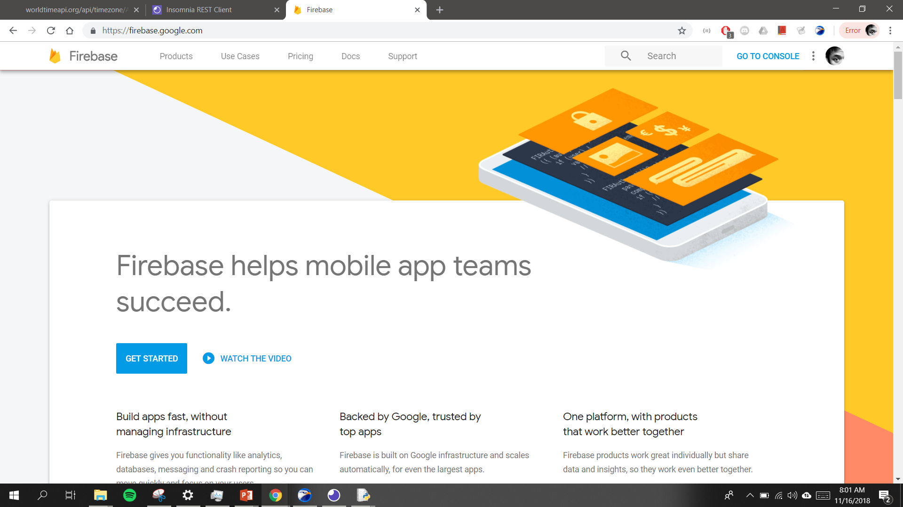
Firebase Real-time Database for IOT application
To get started, first create a Firebase account and then click “GO TO CONSOLE”

Slide 17
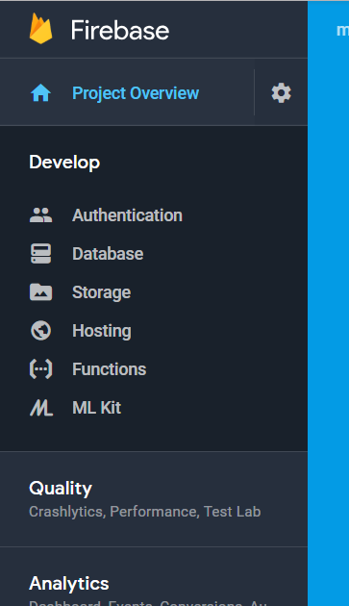
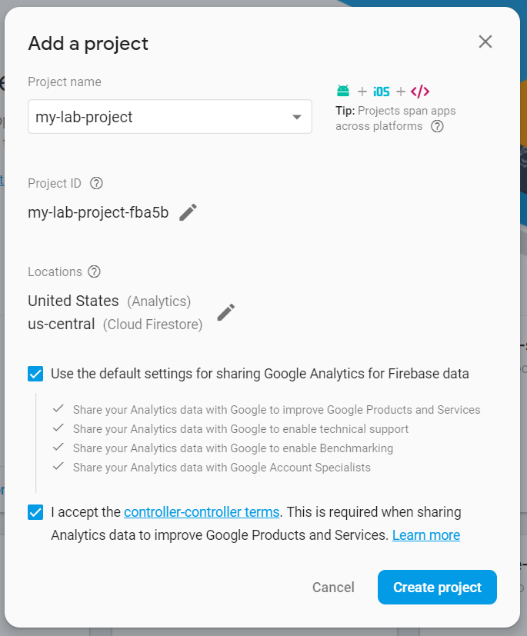
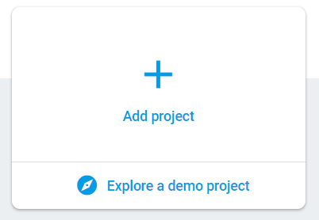
Firebase Real-time Database for IOT application
3
2
Go to Database
Write your preferred project name
1
Add project

Slide 18
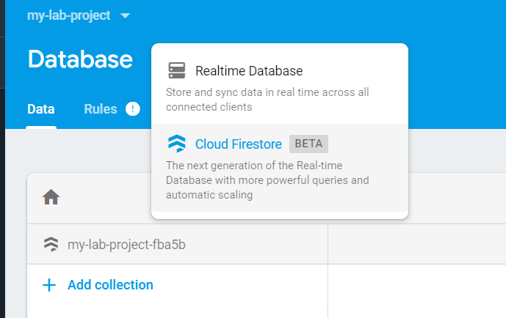
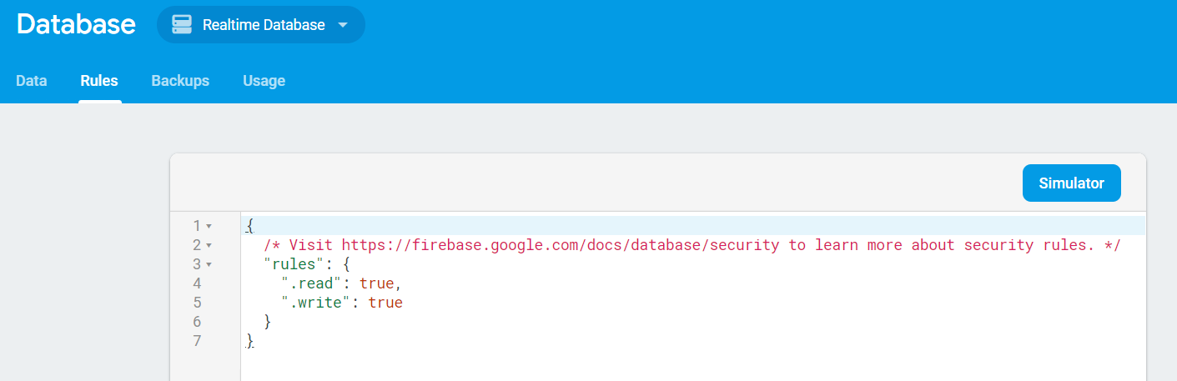
Firebase Real-time Database for IOT application
4
5
Create a Realtime Database
For now change the rules to the following

Slide 19
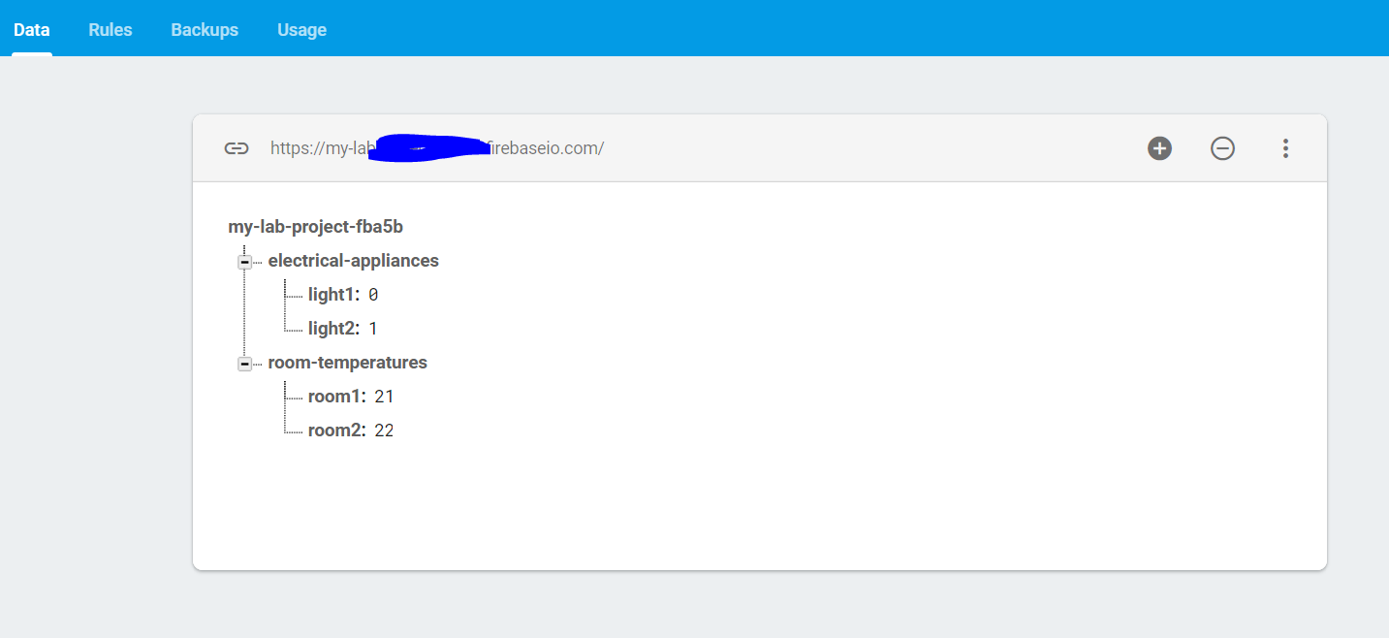
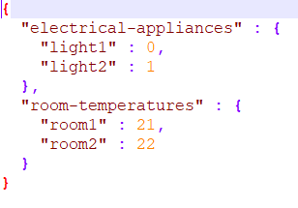
Firebase Real-time Database for IOT application
6
Create a Realtime Database
Your database link
Note the database structure on the left is equivalent to the following json text format
Now try requesting this on your browser:
https://{your database link}.firebaseio.com/.json

Slide 20
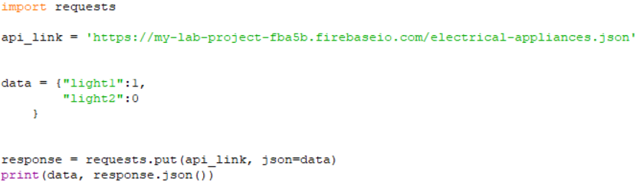
Python’s Requests library
Example 2: Making simple PUT requests
Code to update firebase realtime database using PUT method

Slide 21
Http request a REST Api
Lab activity 2:
Redo our previous RFID tag project (from session 5) but read stored UID from your firebase database.

